Slide 1
Product X Release Y: Concept Commit V1
Josephine Soap
Freda Bloggs
Hugh Jarse

Slide 2
Agenda
Refresh on Feature Creep Delivery Framework
Lessons learned from previous release
Market Context
Proposed Release content
Recommendation
Approvals
Notes:
2

Slide 3
Overview
Role
Phase 1
Concept
Phase 2
Definition & Planning
Phase 3
Development
Phase 4
Readiness
Phase 5
Release
MRD (Market Requirements Document)
Business Case
Sales Planning and Account Targeting
Sales Training
Sales &
Marketing
Go-To-Market
Strategy (inc Channel Strategy)
(Updated) Go-To-Market Plan
Sales Collateral
Sales Validation (with customers)
Go-To-Market Execution
Prescriptive Architectures and Activity Profiles
Release
Requirements
Updated Roadmap
Final
Product Description
Product Management
PRD (Product
Requirements
Document)
Requirements
Baselined
Draft
Product Description
Updated Platform Defn
Platform Defn
Secure Field Trial Customer
Benchmarks
Performance Reqs
Field Trial Plan
Technology
Evaluation
Functional Specification
Design Specification
Design
Complete
Re-work Software
Developer Performance Guidelines
Architecture
Analysis
Unit Test Plan
Development
Product Architecture
Document
Implementation and Unit Test
Feature Complete
Perf design analysis
Performance Design Changes
Integration Test
Integration Complete
Release Notes
Iterative performance adjustments, tuning and testing
Documentation
Documentation Plan
Product Documentation Development
Update Documentation
Test Strategy and Planning
Test Plan and Test Cycle Design
Test Execution
TC
Certification
Test
Test Preparation
Tuning & Benchmarking
CR
GA
Tuning/sizing guidelines
Maintenance
Design Documentation Review
Maintainability Review
Maintenance Acceptance Criteria
Iterative performance adjustments, tuning and testing
Support
Support Operational Impact Statement
Support Training
Field Trial
Add S&M Requirements to PRD
Supportability Review
Add Services Requirements
Install and Deployment Plan
Alpha Trial
Services Training
Install & Deploy + Partner support
Services inc. Training
Custom Benchmarking
Training Assessment
Training Materiel Development
Training Execution
Product Delivery Team Leader
and Project Mgmt
Product Delivery Team Formed
Project Plan Baselined
Product Delivery Team Dissolved
Integrated Project Plan
Post Release
Review
Phase Review
Concept Complete
(RPG Review)
Definition & Planning
Complete
(RPG Review)
Optional Phase Review
Development
Complete
(RPG Review)
Readiness
Complete
(RPG Review)
Release
Complete
(RPG Review)
Feature Status
Key
Project Task
TC = Test Complete
CR = Controlled Release
GA = General Availability
On
the
Radar
Concept
Committed
Development
Committed
Deliverable
Optional
Optional
Notes:
3
3
37
23

Slide 4
Milestone Reviews – what is presented
Phase 1: Concept | Phase 2: Definition and Planning | Phase 3: Development | Phase 4: Readiness | Phase 5: Release
Product Concept Fit with strategy and roadmap Marketing Requirements Target market and size Value proposition to customer | Product Requirements Business case Project schedule Resources required Project costs | Gap between product requirements and actual product Updated business case Updated project schedule and costs | Test results Field trial feedback Launch plan Updated business case Updated project schedule and costs | Initial bookings and revenue Review of development effort Retirement plan

Slide 5
Concept Commit Objectives
Collective Decision
Loosely set release date and Scope
Concept Commit
Development Commit
Definition and Planning
Development
Eliminate all by the most clearly justified product investments
Refine, analyse and cost
Implement
{
Set release date and Scope
You can take away but you shouldn’t add
Specification, design and estimation is a very expensive task – must focus only on those items with high probability of inclusion in final release
Notes:
5

Slide 6
Delivery Process: Checklist
Key
a
done
n
will do
n
u
r
Will do later or delay
Past due
Will not do
Role
a
a
Phase 1
Concept
Phase 2
Definition & Planning
Phase 3
Development
Phase 4
Readiness
Phase 5
Release
MRD (Market Requirements Document)
n
Sales Planning and Account Targeting
Sales Training
Business Case
Go-To-Market
Strategy (inc Channel Strategy)
(Updated) Go-To-Market Plan
Sales Collateral
Sales &
Marketing
Sales Validation (with customers)
Go-To-Market Execution
n
Prescriptive Architectures and Activity Profiles
Release
Requirements
Updated Roadmap
Final
Product Description
Product Management
PRD (Product
Requirements
Document)
Requirements
Baselined
Draft
Product Description
Updated Platform Defn
a
Platform Defn
Secure Field Trial Customer
Benchmarks
r
Performance Reqs
Field Trial Plan
Technology
Evaluation
Functional Specification
Design Specification
Design
Complete
Re-work Software
Developer Performance Guidelines
Architecture
Analysis
Product Architecture
Document
Unit Test Plan
Development
Implementation and Unit Test
Feature Complete
Perf design analysis
Performance Design Changes
Integration Test
Integration Complete
Release Notes
Iterative performance adjustments, tuning and testing
Documentation
Documentation Plan
Product Documentation Development
Update Documentation
Test Strategy and Planning
Test Plan and Test Cycle Design
Test Execution
TC
Certification
Test
Test Preparation
Tuning & Benchmarking
CR
GA
Tuning/sizing guidelines
Maintenance
Design Documentation Review
Iterative performance adjustments, tuning and testing
Maintainability Review
Maintenance Acceptance Criteria
Support
Support Operational Impact Statement
Support Training
Field Trial
Add S&M Requirements to PRD
Supportability Review
Add Services Requirements
Install and Deployment Plan
Alpha Trial
Services Training
Install & Deploy + Partner support
Services inc. Training
Training Materiel Development
Custom Benchmarking
Training Assessment
Training Execution
Product Delivery Team Leader
and Project Mgmt
Product Delivery Team Formed
Integrated Project Plan
Project Plan Baselined
Product Delivery Team Dissolved
Post Release
Review
Phase Review
Concept Complete
(RPG Review)
Definition & Planning
Complete
(RPG Review)
Optional Phase Review
Development
Complete
(RPG Review)
Readiness
Complete
(RPG Review)
Release
Complete
(RPG Review)
Feature Status
Key
Project Task
TC = Test Complete
CR = Controlled Release
GA = General Availability
On
the
Radar
Concept
Committed
Development
Committed
Deliverable
Optional
Optional
Notes:
6
3
37
23

Slide 7
Agenda
Refresh on Feature Creep Delivery Framework
Lessons learned from previous release
Market Context
Proposed Release content
Recommendation
Approvals
Notes:
7

Slide 8
Lessons from Previous Release
Was it a success? Evidence e.g.
Adoption:
new sales
upgrades
Revenue
Market impact
Quality?
Performance?
Timeliness of release?
What went well (do it again)
What didn’t go so well (don’t do it again)
What was the return on the investment

Slide 9
Agenda
Refresh on Feature Creep Delivery Framework
Lessons learned from previous release
Market Context
Proposed Release content
Recommendation
Approvals
Notes:
9

Slide 10
Strategy Radar
100%
Technology
Feature
Business
x%
Mobile Devices
x%
Probability
BitVault
BI Voyage
Compliance Appliance
MoReq2
DOD V3
Blog/Wiki
Filestream
Collaboration Space Mgmt
Web 2.0
.Net 4 WPF
.Net 4 WF
2011
Redaction
SaaS
2010
InfoPath
2009
.Net 3
0%
0%
NOW
Notes:
10

Slide 11
SWOT
Strength
Weakness
Deep Integration & Alignment with MS
Ease of Use (in some contexts)
Unique capabilities:
(Selective) Replication
Hitless upgrade
Install/Ease of Deployment
Performance & Sizing
Lack of management console
Lack of milk steamer
Inconsistent branding and UI
Internal
Opportunity
Threat
SharePoint explosion
RM
Enterprise Policy Management
Hosted/SaaS approach
De-regulation
Endless tiny feature gaps (snowflakes)
Microsoft growing into Workflow space
Technical
Sales engagement
Competitors achieving comparable levels of integration (SharePoint…) because they’re making it easier
External

Slide 12
Differentiation for higher market share
Differentiation and lower price Requires clear understanding and delivery of enhanced value and an advantageous cost base e.g. Ikea
High
Hybrid
Focused Differentiation
Higher perceived value Substantial Price Premium Customer identification essential Often single segment – have to compete within it Can limit growth e.g. Lexus
Perceived Added Value
Low Price
Similar added value at lower price requires low cost base to achieve e.g. Tesco
No Frills
Low price & perceived added value Focus on price sensitive part of market e.g. Primark, Lidl
Low
Low
Price
High

Slide 13
Product Strategy
Market Position:
Leader
Follower
Challenger
Niche Player
Innovation
Pioneer/First Mover
Fast follower
Late follower
Differentiation
Price
Feature
Market Segment/Vertical
Change the rules
Create a new market
Change the value perception
Look for compelling external events such as new regulations, emerging standards, new business models

Slide 14
Competitive Analysis #1
Factor | Our Product | Competitor A | Competitor B | Weight
Market Share | 3 | 5 | 2 | 3
Thought Leadership | 2 | 4 | 6 | 2
Performance | 8 | 4 | 8 | 2
Price | 4 | 7 | 1 | 1
Features | 4 | 6 | 6 | 4
Quality | 4 | 5 | 2 | 2
Totals | 57 | 72 | 63

Slide 15
Competitive Analysis #2
 | Our Product | Competitor A | Competitor B | Competitor C
Feature 1 | Strength | Strength | Weakness | Weakness
Feature 2 | Weakness | Strength | Strength | Strength
Feature 3 | Par | par | par | par
Feature 4 | Par | Weakness | Strength | Weakness
Feature 5 | Weakness | Strength | par | Strength
Feature 6 | Strength | Strength | Strength | par
Feature 7 | None | None | Strength | None
Feature 8 | Par | par | Strength | par

Slide 16
Competitive Analysis 3
Competitor A
Pros:
Cons
Attack Strategy
Blah blah
Defence Strategy
Blah blah

Slide 17
Agenda
Refresh on Feature Creep Delivery Framework
Lessons learned from previous release
Market Context
Proposed Release content
Recommendation
Approvals
Notes:
17

Slide 18
Refresh on MoSCoW Terminology
M
O
S
C
O
W
Must: sine qua non. Anchor features - the function/capability must be delivered and the release is without value if not included
Should: An important feature which clearly adds business value and is highly desired in the release but it may be dropped if necessary to ensure timely delivery of the Must features.
Could: A useful feature but not critical to success and not necessarily a function this org should provide. If resources permit such features may be included.
Won’t!: This feature will not be provided, either because it adds no value, or because resources clearly do not permit its inclusion at this point or because technical obstacles prevent.
Notes:
18

Slide 19
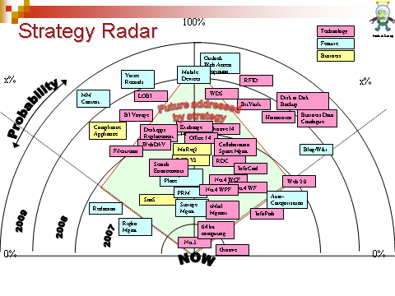
Sources of Requirements
RFEs
Strategy Radar
Market
Internal
Contractual Commitments
High Expectations
Architectural
Performance
Scalability
Extensibility
Supportability
Usability
Security
Quality
Standards
Internationalization
Other “non-functional”
Win/Loss analysis
Analyst Reports
Competitive Analysis
Customer Surveys
User Fora
Customer Advisory Boards
Trade Shows, Conferences
Notes:
19

Slide 20
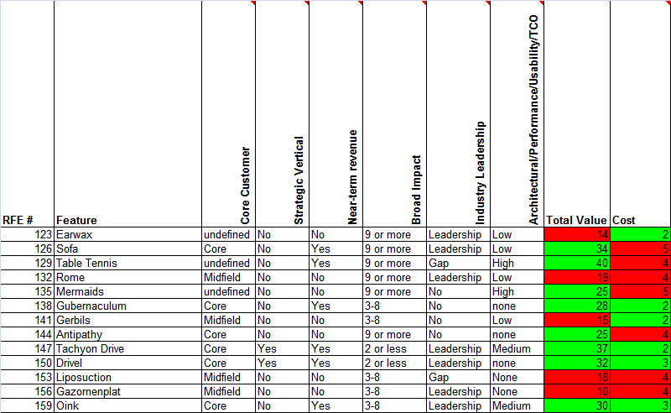
Feature Request Analysis
$$$
High
Medium
Low
None
Strategic Sector
1-2
3-8
9+
Importance
of
Customer
Leap ahead
Close a gap
Neither
Scale of effort:
1 week to 1 year (Log 2)
Notes:
20

Slide 21
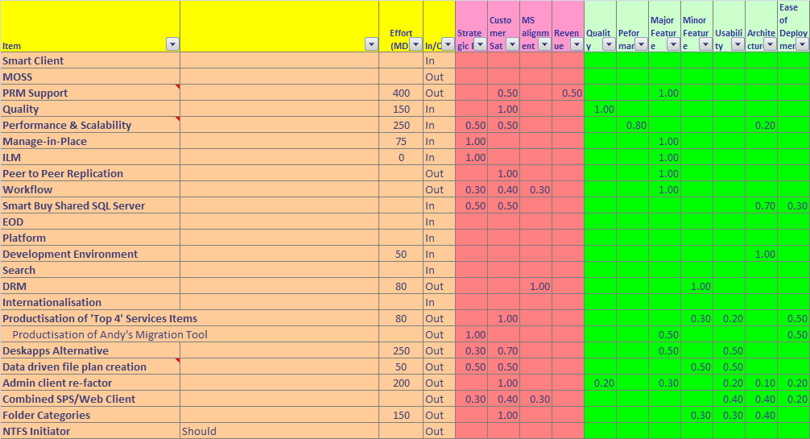
Scope/Delivery Modelling
SAMPLE
Notes:
21

Slide 22
Low Hanging Fruit
Focus on highest-value, lowest cost
Notes:
22

Slide 23
Placing bets

Slide 24
Range of Options
Aggression on
Do Nothing
Stall and watch market
Tactical Move
Strategic Move
Radical
What would a new entrant do?
Minimum to exploit near term
Invest for the future

Slide 25
Do nothing Revenue Model
Assumptions:
5% annual price erosion
0% manufacturing cost increase
30% decline in Product C
5% decline in other products

Slide 26
Turbo Revenue Model
Assumptions:
5% annual price erosion
0% manufacturing cost increase
Products D and E stable
Turbo kills sales of legacy products

Slide 27
Financials
Option | Dev Cost | Unit Price | 2009 Profit | 2010 Profit | 2011 Profit | Total
Do nothing | 0 | n/a | £969,732 | £751,641 | £574,286 | £2,295,659
Turbo | £680,000 | £315 | £1,334,877 | £1,317,093 | £1,201,755 | £3,853,724

Slide 28
Roadmap (six qtr view)
Q1 09
Q2 09
Q3 09
Q4 09
Q1 10
Q2 10
New Product V3
New Product V2
New Product V1
Legacy Product C
Legacy Product B
Legacy Product A

Slide 29
Option A: Investment Balance
Release Cost £1.1M
Notes:
29

Slide 30
Option B: Investment Balance
Release Cost £957,950
Notes:
30

Slide 31
Agenda
Refresh on Feature Creep Delivery Framework
Lessons learned from previous release
Market Context
Proposed Release content
Recommendation
Approvals
Notes:
31

Slide 32
Overview (if necessary)
Theme of release
Key features, characteristics
Technical challenges and their currently proposed resolution
General business case

Slide 33
Feature 1
Feature description (high level)
Why needed
Business case
Sales enabled (Market share)
Displacements avoided
Competitor displacements
Consequence of doing nothing?
Impact of delaying to a later release?

Slide 34
Agenda
Refresh on Feature Creep Delivery Framework
Lessons learned from previous release
Market Context
Proposed Release content
Recommendation
Approvals
Notes:
34

Slide 35
Pitch Structure
For <target customers> who are dissatisfied with <current alternative>,<our product> is a <new product category> that provides <key problem solving opportunity>. Unlike a <competitive substitute>, we have assembled <key whole product features>.
Example - Palm Pilot
For travelling executives who are dissatisfied with Franklin Planners, the Palm Pilot is a personal digital assistant that provides rapid access to phone numbers and appointments. Unlike the Sharp Wizard, the Pilot can easily synchronize your data with your PC and fits in your shirt pocket.

Slide 36
Alternative Pitch Template

Slide 37
Focus on Business benefits
✗
Scalable
Flexible
Fault tolerant
✓
Increase your revenues
Reduce your risk exposure
Cut costs by 30%

Slide 38
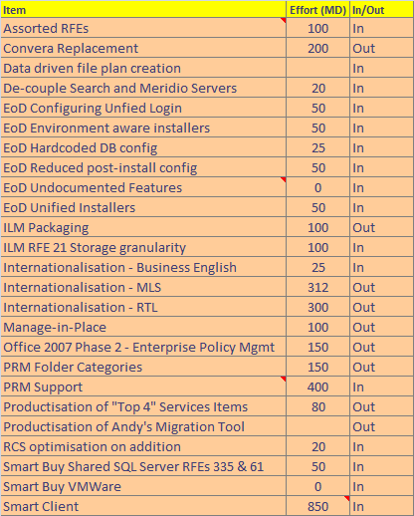
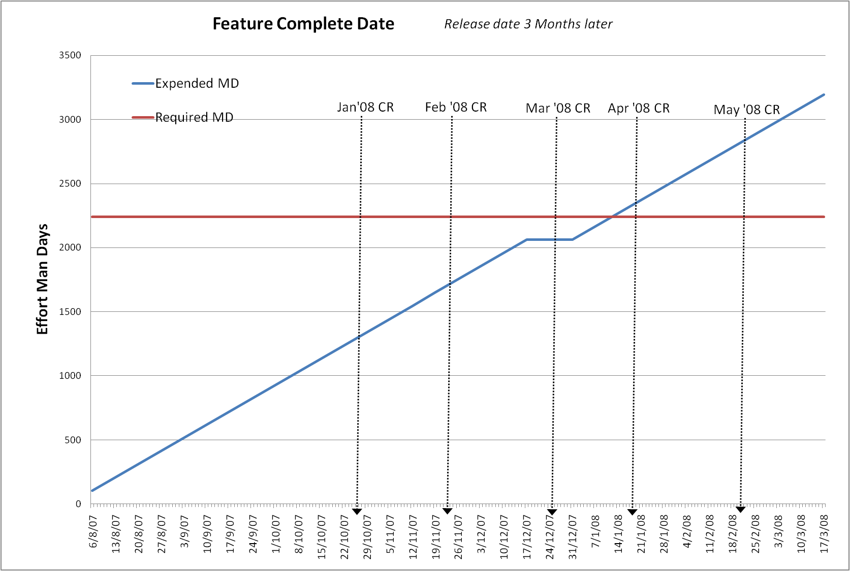
Option A – Blah Blah Blah
Multi keyword select
Licence reporting
Not Searching
Feature Complete End Jan ‘08
Controlled Release End April ‘08
Generally Available July ‘08
Notes:
38

Slide 39
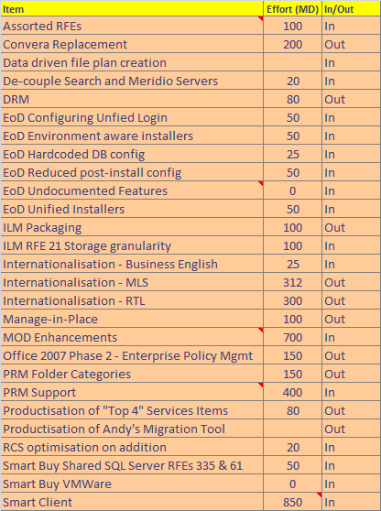
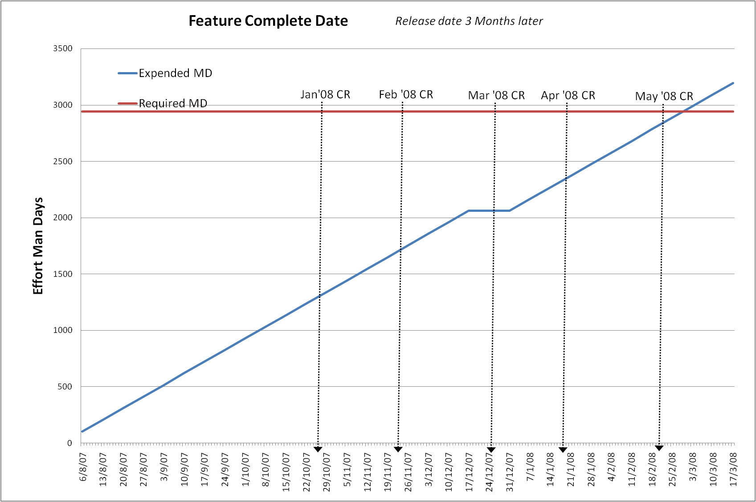
Option B – Blah Blah Blah
Multi keyword select
Licence reporting
Not Searching
Feature Complete End March ‘08
Controlled Release End June ‘08
Generally Available Sept ‘08
Notes:
39

Slide 40
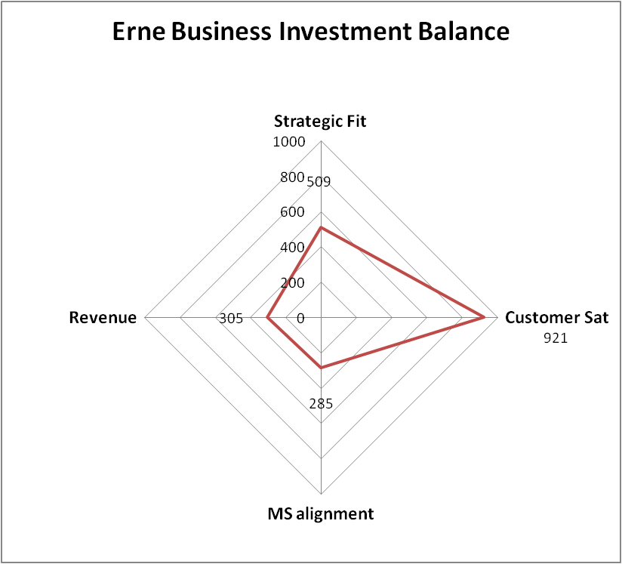
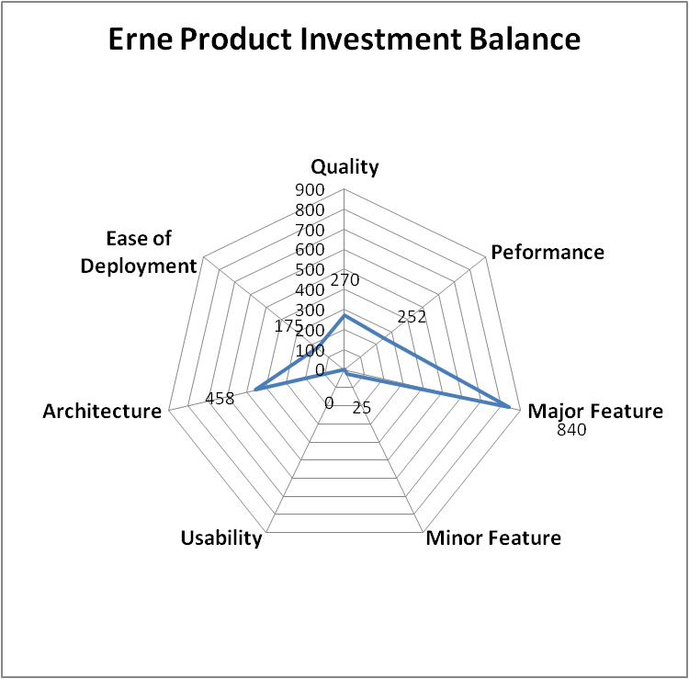
Option A: Investment Balance
Release Cost £1.1M
Notes:
40

Slide 41
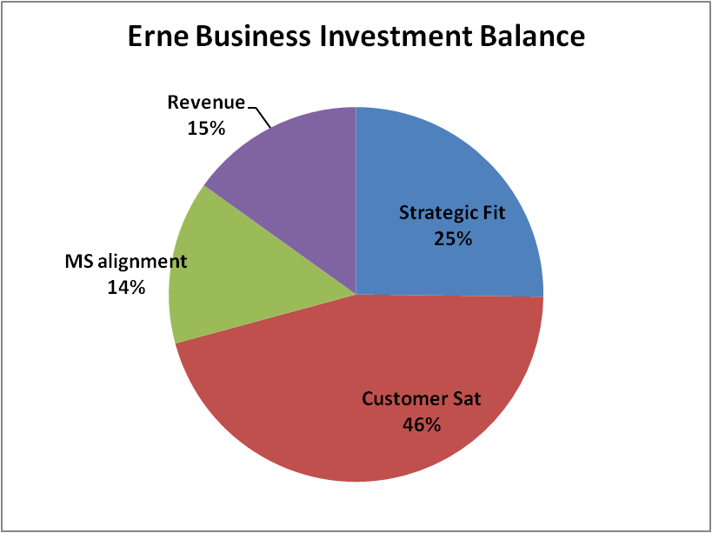
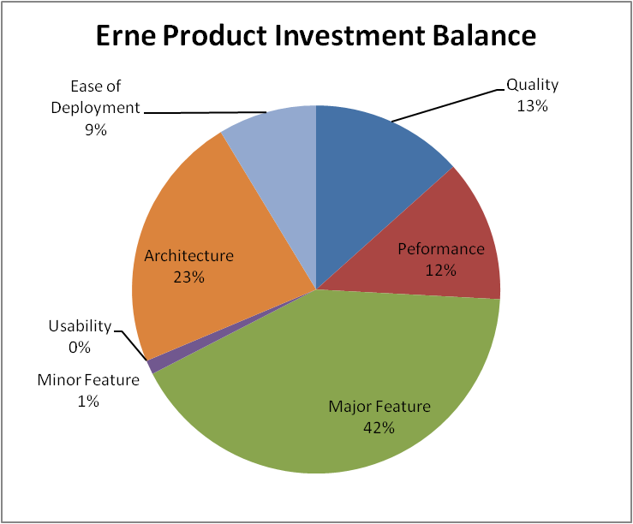
Option A: Investment Balance
Release Cost £1.1M
Notes:
41

Slide 42
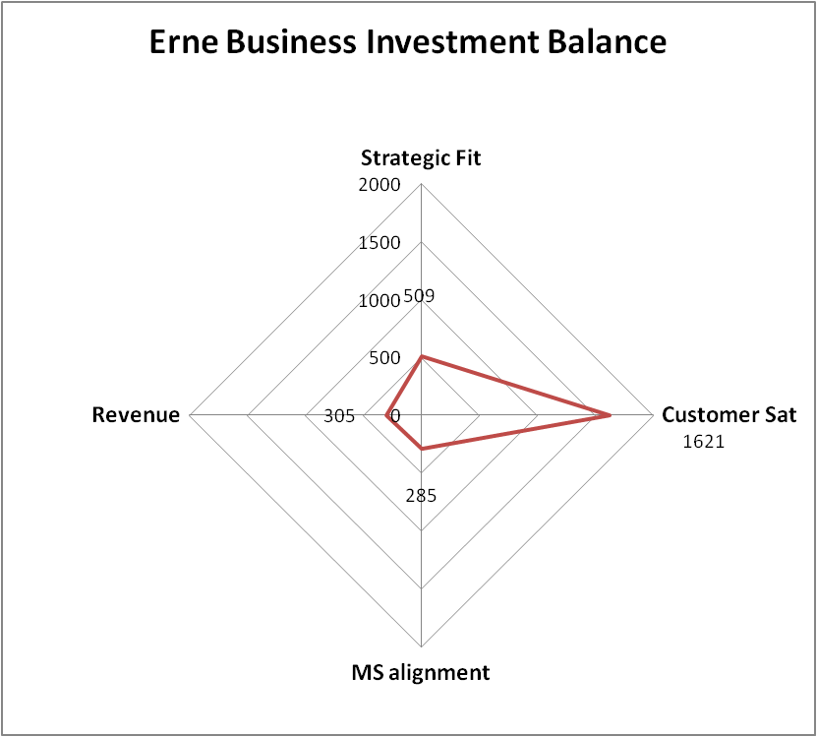
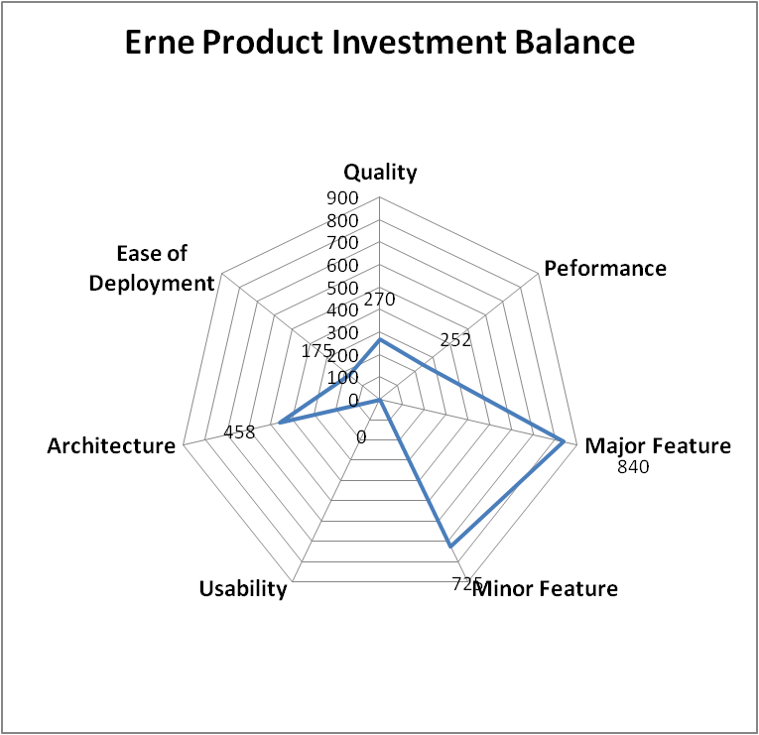
Option B: Investment Balance
Release Cost £1.45M
Notes:
42

Slide 43
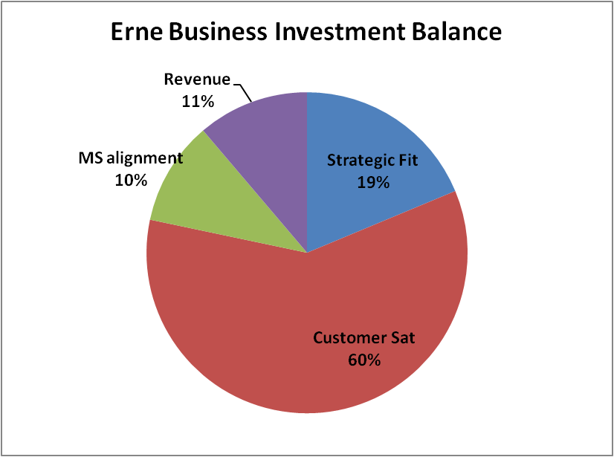
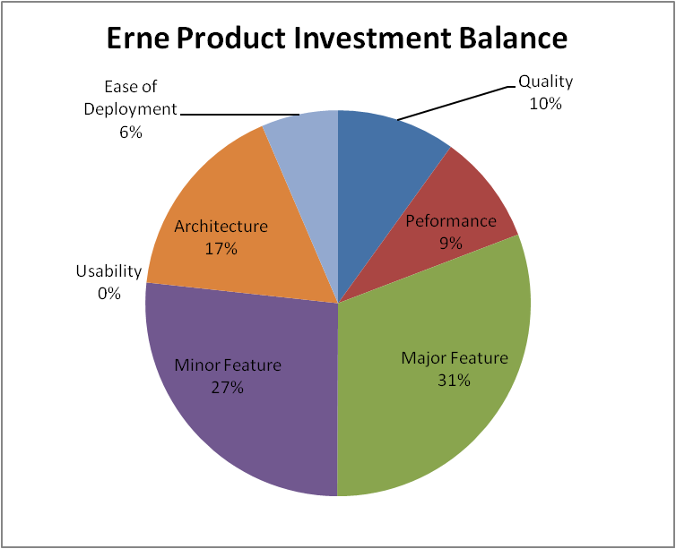
Option B: Investment Balance
Main Difference from Option A:
Large basket of Minor Features
Most are Generic
Release Cost £1.45M
Notes:
43

Slide 44
Options
Option | Cost | Delivery Date | Year 1 Revenue | Year 2 Revenue | Year 2 Revenue | 3 Year ROI
Notes:
44

Slide 45
Recommendation
Proceed with Option A
Ball part cost £xx
Feature Complete End Jan ‘09
Controlled Release End April ‘09
Generally Available July ‘09
Negotiate with Customer X – reduce/defer/charge (and buy resource)
Hire 3-6 new (C++?) Developers (>3 de-risk, accelerate)
Look for ways to reduce CDR effort
Underpin the major features with better revenue numbers by Development Commit
At Development Commit adjust as necessary to balance date with scope
Development Commit on Date
Cost to achieve Development Commit: £XXX
Notes:
45

Slide 46
Major Risks and Planned Response
High/High precludes “Go” decision
Area | Nature of Risk | Probability | Impact | Planned Response (Owner)
Technical | Clock recovery may hit unforeseen technical problems | Low | Medium | Complete design asap Fully resource team (skills and numbers)
Schedule/ Resource | Inability to hire right skills quickly to enable MPEG encoding work to proceed at optimum speed | Med | High | Advertise soon
Commercial | Inability to negotiate customer X to manageable set of features | Med | High | Begin discussions soon
Market | Korean market throws up new “MUST” features. | Medium | High | Stay awake
Market | Our doohickey is seen as an incomplete offering | Low | Medium | None
Market | Time to market for major features (e.g. Reaction of existing customers to date for availability of 4 port card) | High | Medium | Test with field Keep them close – involve in design. Sign up to adopt early.
Notes:
46

Slide 47
Agenda
Refresh on Feature Creep Delivery Framework
Lessons learned from previous release
Market Context
Proposed Release content
Recommendation
Approvals
Notes:
47

Slide 48
Approvals
Dept | Approval: Go/No Go
EMEA
NAM
CALA
APAC
CEO
CTO
Finance
Marketing
Support Maintenance & Test
Research
Development
Product Management
Notes:
48

Slide 49

Questions?

Slide 50
Disclaimer
Due to the forward-looking nature of this Roadmap, Feature-Creep includes information about products that are in the planning stage of development or that represent custom features or product enhancements. Functionality cited in this document that is not publicly available is discussed within the context of the strategic evolution of the proposed products. This document is for informational purposes only. The information in this document is provisional and is subject to change without notice. Nothing in this document should be considered as a commitment by Feature-Creep in relation to future functionality, release dates, product roadmaps or any other matter. Feature-Creep MAKES NO WARRANTIES, EXPRESS OR IMPLIED, IN THIS DOCUMENT.

Slide 51
Feature Status Definitions
“Radar” | “Concept Committed” | “Development Committed”
The feature has been identified as a potential future feature Deliverables created: TBD (feature description) The feature has been prioritized by the management team and it has been decided that we will spend additional resources to determine if it is technically feasible and fits within the product strategy More information required to determine the actual release Probability of the feature going to market Medium-Low Probability of the feature going to market in the targeted release Low | The feature has completed a business case and most product and market requirements have been defined Deliverables created: Business Case Or Drafts of PRD and MRD The management team has approved resources to complete the product and market requirements, functional specifications, development and implementation plan, and perform any technical feasibility studies The management team has updated the “target release” More information required to determine the actual release Probability of the feature going to market Medium-High Probability of the feature going to market in the targeted release Medium | The feature has been approved to be developed Deliverables created: Business Plan PRD and MRD Development and Implementation Plans Functional Specification A management team has approved resources to complete the development of the feature The management team has placed the feature in a “locked” release We are spending resource to ensure the feature is included in the “locked” release Probability of the feature going to market High Probability of the feature going to market in the “locked” release High
" Due to the forward-looking nature of this Roadmap, Feature-Creep includes information about products that are in the planning stage of development or that represent custom features or product enhancements. Functionality cited in this document that is not publicly available is discussed within the context of the strategic evolution of the proposed products. This document is for informational purposes only. The information in this document is provisional and is subject to change without notice. Nothing in this document should be considered as a commitment by Feature-Creep in relation to future functionality, release dates, product roadmaps or any other matter. Feature-Creep MAKES NO WARRANTIES, EXPRESS OR IMPLIED, IN THIS DOCUMENT. "

Slide 52
Feature-Creep Roadmap 2008
Timeline | July 2008 | Q4 2008 | Q2 2009
Release | Gerbil | Hamster | Shrew
Theme | Replication & Distribution Smart clients | Physical Records Management eMail Management | Office 12 support Advanced Physical Records Management Manage-in-place APIs
Core Features | Feature 1 Feature 2 Feature 3 Feature 4 Feature 5 | Feature 1 Feature 2 Feature 3 Feature 4 | Feature 1 Feature 2 Feature 3
Optional Features | Feature 1 Feature 2 Feature 3 Feature 4 Feature 5 | Feature 1 Feature 2 Feature 3 Feature 4 Feature 5 | Feature 1 Feature 2 Feature 3
Platforms OS/DB | Windows 2000, XP Office 2003 .Net 1.1 | Windows 2000, XP Office 2003 .Net 1.1 | Windows 2000, XP Office 2007 .Net 2.0
Feature Status
Development Committed
Concept Committed
Radar

