Slide 1


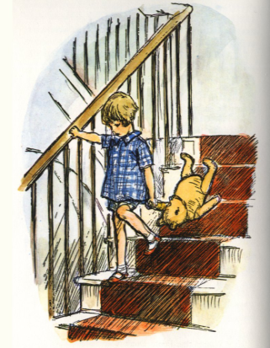
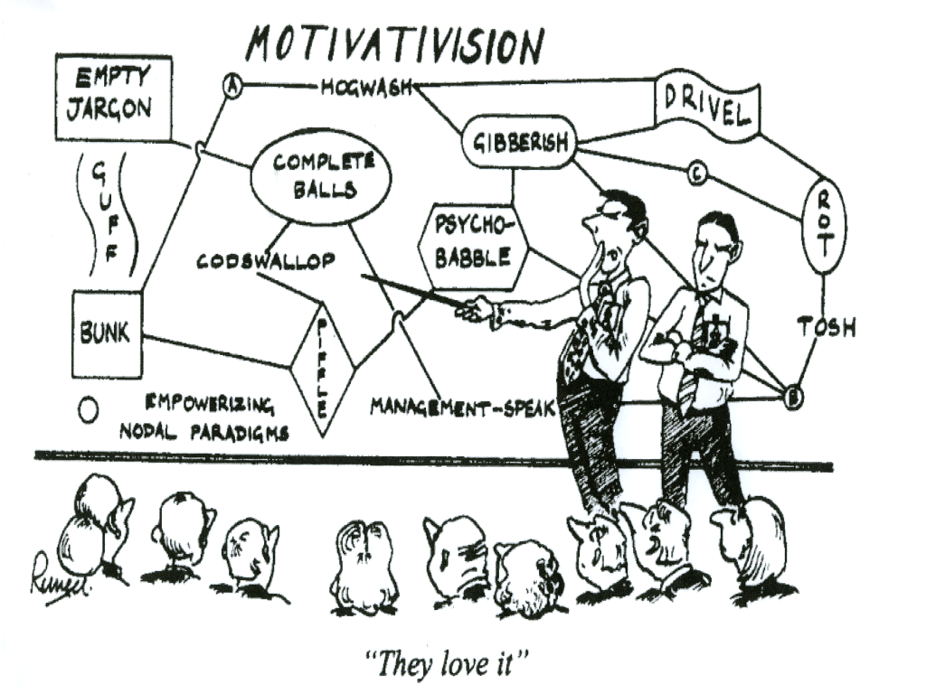
Roadmap 2008 - 2010
Feature Creep: Make the right
thing and make the thing right
Feature Creep Technology
Here is Edward Bear coming downstairs now, bump, bump, bump on the back of his head, behind Christopher Robin.
It is, as far as he knows, the only way of coming downstairs, but sometimes he feels there really is another way, if he could just stop bumping for a moment and think of it
Product Vision
Agility
Can leap tall buildings in a single bound
Deploys faster than you can erect a deckchair
Can perform any function simply by re-arranging the ones and zeros
Scalability and Redundancy
Product Components
If you treat the people around you with love and respect, they will never guess that you're trying to get them sacked.
If at first you don't succeed, remove all evidence you ever tried.
Avoid employing unlucky people - throw half of the pile of CVs in the bin without reading them.
You have to be 100% behind someone, before you can stab them in the back.
Eagles may soar, but weasels don't get sucked into jet engines.
Smaller than an ant’s nuts or as big as a whale’s willy – you decide
Geographic and logical failover – we’ve made it brittle so we can sell you more of them
Runs on any operating system*
Collaboration
Facilitate collaboration across teams and locations
Uses fewer muscles than frowning
Individually you can do nothing, but together you can agree that nothing can be done
Healthy
Naturally low in rat droppings
Can radically increase weight-loss when used as part of a food-free diet
Enriched with poly-gamma-hydro-liposomes, B52 and soluble roughage
Soft Toilet Paper
Kind to the bottom
No more bunged up toilets
Manufactured from sustainable forests by nice people
*So long as it’s Windows XP, Service Pack 3

Slide 2
Version 2.5
Matter Transportation
Version 3.1
World Peace
Version 4.1
Fault Tolerance
Version 2.6
Microsoft Integration
Version 3.0
Environmentally Friendly
Version 4.0
Eternal Life
Version 3.2
Time Travel
Q1 2008
Q2 2008
Q3 2008
Q4 2008
Q1 2009
Q2 2009
Q3 2009
Q4 2009
Q1 2010
Q2 2010
Q3 2010
Q4 2010
  Sept 2008 – Ver 2.5
  Matter Transportation
  Send objects as far as you can carry them
  Pulps fruit, and anything else you transport
  Powered by room temperature fusion
  Doesn’t necessarily kill you
  Choice of beige
  Sept 2009 – Ver 3.1
  World Peace
  Brings people together
  Agnostic
  NATO certified
  Supports Hebrew, Arabic, Gaelic and Scots Irish
  Jan 2009 – Ver 2.6
  Microsoft Integration
  Comes with a “Microsoft integration” sticker
  Installs on Windows XP (but doesn’t run)
  Runs on Windows Vista (but doesn’t install)
  Buggers up the registry good and proper
  Has the word “SharePoint” in the manual
  I met Steve Ballmer in a hotel lift once
  Jan 2010 – Ver 3.2
  Time Travel
  Travel forward in time to when this product is really going to be available
  Travel backwards in time to get the requirements right
  Jul 2010 – Ver 4.0
  Eternal Life
  User response times will make you feel that time has stopped
  You’ll pray for death
  Mar 2009 – Ver 3.0
  Environmentally Friendly
  Reduced greenhouse gas emission
  Lower gamma radiation levels
  Hardly any asbestos at all
  Reduced increase in power consumption
  Edible packaging
  Jan 2011 – Ver 4.1
  Fault Tolerance
  We don’t care if it crashes
  Comes with lucky sprig of heather
  Automatically recovers from errors by spontaneously rebooting at random intervals
Roadmap commitments are firm for the next release; the schedules and contents for subsequent releases are subject to change.
© Feature Creep 2008 – Company Confidential

