Slide 1
Product Management: Building the right thing
Want to make God laugh? Tell him you have plans.

Slide 2
Why do Technology Vendors fail?
Rarely because they couldn’t produce software or hardware…
Wrong Product
Lack of internal alignment
Quality too high (expensive)
TCO too high
Quality too low (unusable)
Falling behind
the competition
Incoherent portfolio
Not competitively priced or packaged
Couldn’t exploit foreign markets
Not showing “vision” or compelling product roadmap
Not marketed effectively
Don’t evolve in line with customers needs
Insufficiently flexible
Wrong Customers
Didn’t take account of new technologies
Didn’t take account of changing business models
Fragmented codelines
Didn’t scale
Not fit for purpose
Over-invested in features

Slide 3
A product organisation comprises…
Program(me) Managers
Technical Writers
Technical Product Support
Sales
Product Managers
Product Marketing
Continuing Engineering
Delivery/Release Managers
Professional Services
Curriculum Development
Trainers
Sales Engineers
Consultants
Business Development
Account Managers
GUI designers
Performance Engineers
Sizing Engineers
Patent Lawyers
Legal
Finance

Slide 4
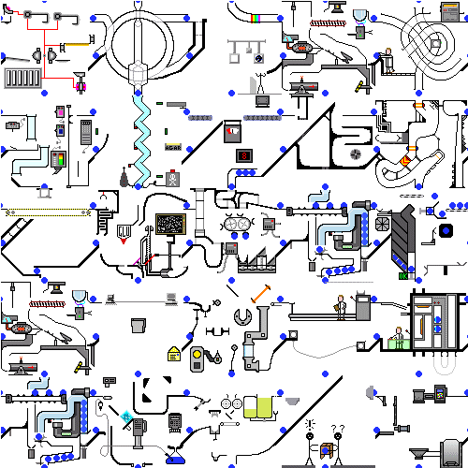
Without something to align them
Lots of activity but no discernible output

Slide 5
Two fundamental challenges
How to invest scarce resources to most effect
How to align all the business activities (functions) around the product releases
Product Management is the role and process that solves these problems

Slide 6
Product Management
Align product strategy with company strategy
Who are our customers?
What are their problems?
Which ones will they trust us to solve?
How will we solve them?
Who will we partner with?
Manage Requirements
Capture
Analyse
Value/Effort (Business Case)
Prioritise (MoSCoW)
Detailed definition
Create collateral
Manage the life cycle
Now and in the Future!
Sales
Market
Product Management
Engineering

Slide 7
Product Management Interfaces
Market
Sales
Partners
Services
Customers
Pre-Sales
Competitors
Sales
Marketing
Analysts
Prospects
Product Management
Execs
Both Glue and Oil!
Engineering
Support
Development
QA

Slide 8
Product Management Interfaces
Market
Sales
White Papers
Competitive Analysis
Feature Specs
Training
Market Requirements Definitions
(MRD)
Collateral
Roadmap
Collateral
Product Management
Presos Demos
Execs
Product Strategy
Business Cases
Engineering
Product Requirement
Definitions
(PRD)
Roadmap

Slide 9
Key elements of Role
Understand the market
Identify requirements (customer & market)
Manage Product Lifecycle
Developing Positioning, Packaging & Pricing
Collaborate with Marketing on “go to market” strategy
Support Sales engagements
Engage with customers and provide feedback loop

Slide 10
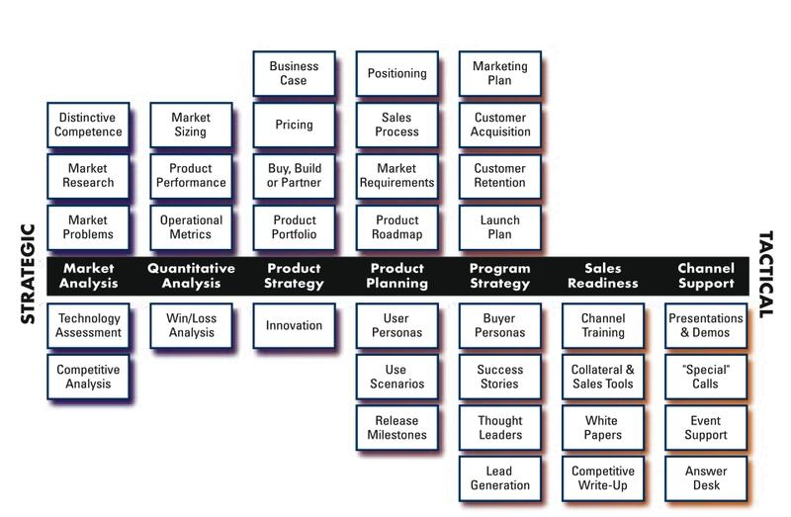
Scope of Product Management
In a given company, the division of labour may move some of these roles into Marketing or Sales and Product Management will act in support
Use RASCI to ensure clear agreement on roles
Copyright Pragmatic Marketing

Slide 11
Product Management Skills & Behaviour
Technical (often ex-Developer/QA)
Communications (comfortable in front of customers, analysts, senior management)
Planning
Vision
Commercial/Business
Strong sense of purpose
Listening
Understand the market

Slide 12
Making the right investment

Slide 13
Strategy Radar
100%
Technology
Feature
Outlook Web Access Integration
Business
x%
Voice Records
Mobile Devices
RFID
x%
Probability
WDS
MM Content
LOBI
Disk to Disk Backup
BitVault
BI Voyage
Harmonica
Business Data Catalogue
Future addressed
by strategy
Compliance Appliance
Deskapps Replacement
Exchange 14
Groove 14
Office 14
WebDAV
MoReq2
Collaboration Space Mgmt
Blog/Wiki
Filestream
Search Enancements
DOD V3
RDC
Manage in Place
InfoCard
.Net 4 WCF
Web 2.0
PRM
.Net 4 WPF
.Net 4 WF
2009
SaaS
Auto-Categorisation
2008
Storage Mgmt
eMail Mgmnt
Redaction
InfoPath
2007
Rights Mgmt
64 bit computing
.Net 3
0%
Groove
0%
NOW
Notes:
13

Slide 14
SWOT
Strength
Weakness
Deep Integration & Alignment with Microsoft
Esp Outlook & SharePoint
Ease of Use
Unique capabilities:
(Selective) Replication
Smart Shortcut
Cycle time (legacy, complexity)
Install/Ease of Deployment
Performance & Sizing
Inconsistencies across clients
Internal
Opportunity
Threat
SharePoint explosion
RM
Enterprise Policy Management
Hosted/SaaS approach
De-regulation
Microsoft growing into our space
Technical
Sales engagement
Competitors achieving comparable levels of integration (SharePoint…) because they’re making it easier
External

Slide 15
Differentiation for higher market share
Differentiation and lower price Requires clear understanding and delivery of enhanced value and an advantageous cost base e.g. Ikea
High
Hybrid
Focused Differentiation
Higher perceived value Substantial Price Premium Customer identification essential Often single segment – have to compete within it Can limit growth e.g. Lexus
Perceived Added Value
Low Price
Similar added value at lower price requires low cost base to achieve e.g. Tesco
No Frills
Low price & perceived added value Focus on price sensitive part of market e.g. Primark, Lidl
Low
Low
Price
High

Slide 16
Product Strategy
Market Position:
Leader
Follower
Challenger
Niche Player
Innovation
Pioneer/First Mover
Fast follower
Late follower
Differentiation
Price
Feature
Market Segment/Vertical
Change the rules
Create a new market
Change the value perception
Look for compelling external events such as new regulations, emerging standards, new business models

Slide 17
Successful Products
Are fit for purpose
Offer value for money
Can easily be understood – i.e. dominant features are clearly of value (avoid Swiss Army Knife syndrome)
Are robust – mtbf meets market needs
Meet the needs of all user groups e.g. end-users, installers, support desk, management etc
Have at least one differentiating attribute (may be an attribute of the company rather than the product). People need a reason to buy

Slide 18
Competitive Intelligence
Analysts – Forrester, Gardner, Ovum etc
Trade Shows and Conferences
Web trawls
Friendly Customers
Surveys (keep them simple)
Trade press
Watch out for:
New entrants
Adjacencies:
Companies providing technology adjacent to yours who might become competitors
Opportunities to compete in the adjacent spaces

Slide 19
Competitive Analysis #1
Factor | Our Product | Competitor A | Competitor B | Weight
Market Share | 3 | 5 | 2 | 3
Thought Leadership | 2 | 4 | 6 | 2
Performance | 8 | 4 | 8 | 2
Price | 4 | 7 | 1 | 1
Features | 4 | 6 | 6 | 4
Quality | 4 | 5 | 2 | 2
Totals | 57 | 72 | 63

Slide 20
Competitive Analysis #2
 | Our Product | Competitor A | Competitor B | Competitor C
Feature 1 | Strength | Strength | Weakness | Weakness
Feature 2 | Weakness | Strength | Strength | Strength
Feature 3 | Par | par | par | par
Feature 4 | Par | Weakness | Strength | Weakness
Feature 5 | Weakness | Strength | par | Strength
Feature 6 | Strength | Strength | Strength | par
Feature 7 | None | None | Strength | None
Feature 8 | Par | par | Strength | par

Slide 21
Competitive Analysis 3
Competitor A
Pros:
Cons
Attack Strategy
Blah blah
Defence Strategy
Blah blah

Slide 22
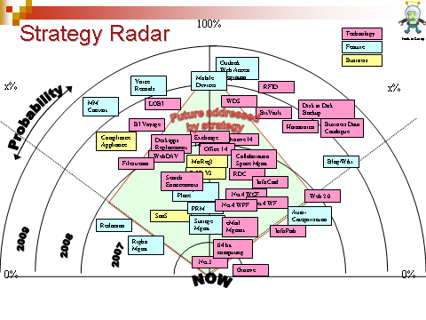
Sources of Requirements
RFEs
Strategy Radar
Market
Internal
Contractual Commitments
High Expectations
Architectural
Performance
Scalability
Extensibility
Supportability
Usability
Security
Quality
Standards
Internationalization
Other “non-functional”
Win/Loss analysis
Analyst Reports
Competitive Analysis
Customer Surveys
User Fora
Customer Advisory Boards
Trade Shows, Conferences
Notes:
22

Slide 23
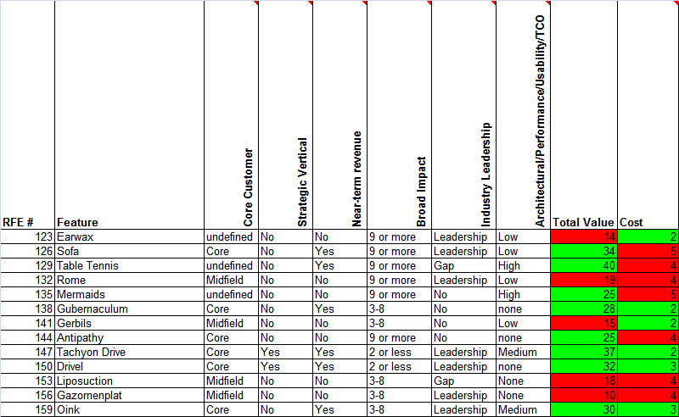
Feature Request Analysis
$$$
High
Medium
Low
None
Strategic Sector
1-2
3-8
9+
Importance
of
Customer
Leap ahead
Close a gap
Neither
Scale of effort:
1 week to 1 year (Log 2)
Notes:
23

Slide 24
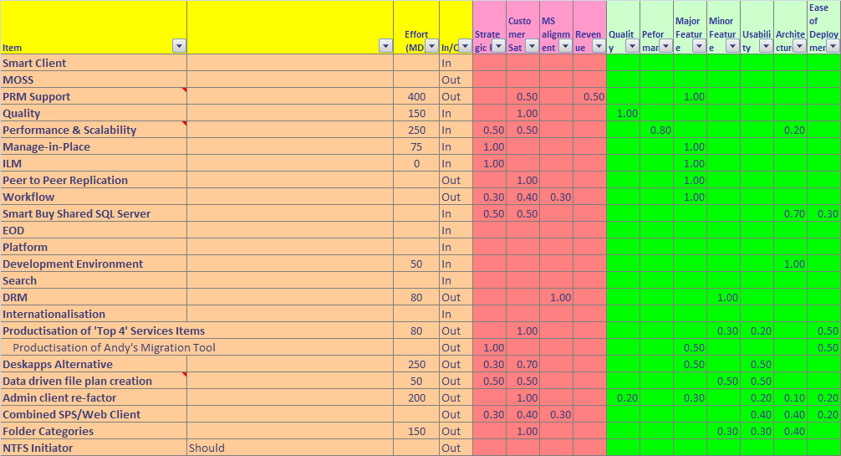
Scope/Delivery Modelling
SAMPLE
Notes:
24

Slide 25
Use MoSCoW Requirements Management
Managing requirements in this way is an enabler for moving to release trains, and in general it greatly simplifies the release planning and management process.
Be brutal in constraining the “Must” features for a given release and give Engineering the flexibility they need to succeed.
Don’t commit Should and Could features to Customers!
Notes:
25

Slide 26
Option A: Investment Balance
Release Cost £1.1M
Notes:
26

Slide 27
Option B: Investment Balance
Release Cost £957,950
Notes:
27

Slide 28
Placing bets
Avoid:
Placing too many bets – especially small ones
Making a single large risky bet
Not making enough long term strategic investment to ensure future

Slide 29
Things to watch out for…
Product Management should specify “what” the product does, but not “how” it does it – leave the “how” to engineering if you want to stay friends.
This can become fuzzy when it comes to UI design since the “what” and the “how” overlap – so collaborate and prototype.
Involve end-users whenever possible; don’t make assumptions about their skills and preferences
Consider all the stakeholders – i.e. all the different user groups, and those that install, maintain, administer and support the deployed product
Consider all the failure modes – be imaginative when thinking about the stupid things people might do, or things that might break. Don’t specify and design for a perfect world.

Slide 30
Aligning the Business

Slide 31

The Waterfall looks like this:
The waterfall model is a special case of such rarity in the real software industry as to be of no interest
Notes:
31

Slide 32
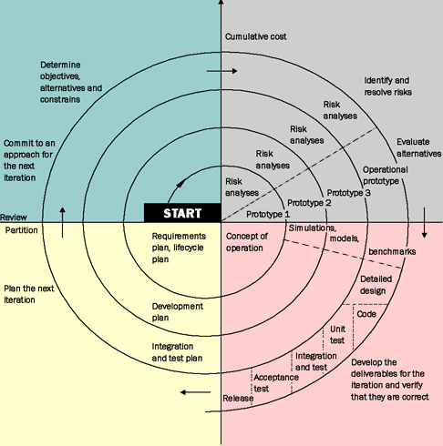
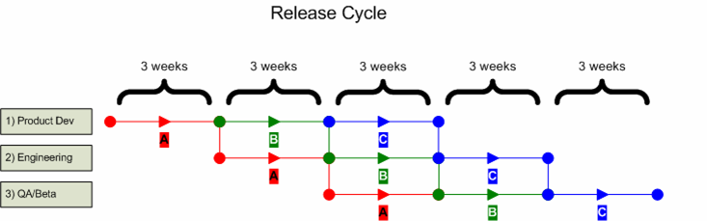
Spirals or Trains
In practice product development will follow either a spiral or release train model. The characteristics are essentially the same but release trains usually have a fixed cadence.

Slide 33
Product Release Framework
End-to-end product lifecycle planning process.
Defines the lifecycle in terms of distinct project phases
Each functional unit in the business is responsible for defined tasks and deliverables in each phase
Governance is provided by a Product Delivery Team (PDT) chaired by Product Management
Each functional group is represented by a Product Delivery Team Member
The PDT is accountable to the overall business leadership (C level execs and key stakeholders)
Notes:
33

Slide 34
Overview
Distinct phases in the project from concept through to delivery
Workflow Model
Role
Phase 1
Concept
Phase 2
Definition & Planning
Phase 3
Development
Phase 4
Readiness
Phase 5
Launch
Project
Mandate
Business Case
Release
Requirements
Requirements
Baselined
Draft
Product Description
Final
Product Description
Product Management
PRD (Product
Requirements
Document)
Secure Field Trial Customer
Channel Strategy
Channel Development
Functional groups represented by a Product Delivery Team Member
Marketing
Sales
Validation
Package
Go-To-Market
Strategy
Sales Planning and Account Targeting
Sales Validation
Go-To-Market Plan
Go-To-Market Execution
Technology
Evaluation
Functional Specification
Design Specification
Design
Complete
Development
System
Architecture
Analysis
Product Architecture
Document
Construction and Unit Test
Code
Complete
Update Software
Interface Control
Document
Installation & Integration Test
Integration Complete
Training and
Documentation
Documentation Plan
Product Documentation Development
Update Documentation
Training Plan
Training Development
Training Execution
Test
Test Analysis
Test Plan and Test Design
Test Execution
TC
CR
Field Trial Plan
EA
Field Trial
GA
Design Documentation Review
Maintenance
& Support
CE Acceptance Criteria
TPS User Documentation Review
TPS Release Evaluation and Feedback
Transition
to CE
Project activities coordinated by a Product Manager
TPS Operational Impact Statement
Global
Services
Add M&S Requirements to PRD
Install and Deployment Plan
Install & Deploy
Product Delivery Team Leader
and Project Mgmt
Product Delivery Team Formed
Integrated Project Plan
Project Plan Baselined
Post Launch
Review
Product Delivery Team Dissolved
Phase Review
Phase review points where the project team presents to the Company leaders
Notes:
34

Slide 35
Project Phases
Phase 1. Concept
Phase 2. Definition and Planning
Phase 3. Development
Phase 4. Readiness
Phase 5. Release
Workflow Model
Role
Phase 1
Concept
Phase 2
Definition & Planning
Phase 3
Development
Phase 4
Readiness
Phase 5
Launch
Project
Mandate
Business Case
Release
Requirements
Requirements
Baselined
Draft
Product Description
Final
Product Description
Product Management
PRD (Product
Requirements
Document)
Secure Field Trial Customer
Channel Strategy
Channel Development
Marketing
Sales
Validation
Package
Go-To-Market
Strategy
Sales Planning and Account Targeting
Sales Validation
Go-To-Market Plan
Go-To-Market Execution
Technology
Evaluation
Functional Specification
Design Specification
Design
Complete
Development
System
Architecture
Analysis
Product Architecture
Document
Construction and Unit Test
Code
Complete
Update Software
Interface Control
Document
Installation & Integration Test
Integration Complete
Training and
Documentation
Documentation Plan
Product Documentation Development
Update Documentation
Training Plan
Training Development
Training Execution
Test
Test Analysis
Test Plan and Test Design
Test Execution
TC
CR
Field Trial Plan
EA
Field Trial
GA
Design Documentation Review
Maintenance
& Support
CE Acceptance Criteria
TPS User Documentation Review
TPS Release Evaluation and Feedback
Transition
to CE
TPS Operational Impact Statement
Global
Services
Add M&S Requirements to PRD
Install and Deployment Plan
Install & Deploy
Product Delivery Team Leader
and Project Mgmt
Product Delivery Team Formed
Integrated Project Plan
Project Plan Baselined
Post Launch
Review
Product Delivery Team Dissolved
Phase Review
Each project phase has a corresponding end of phase Review, where project status, issues and recommendations are presented
Notes:
35

Slide 36
Functional Groups
Product Management (lead)
Marketing
Development
Test
Documentation
Support & Maintenance
Services inc. Training
Development
Product
Management
Global
Services
Sales
Product Delivery TeamLeader*
Training &
Documentation
Product Delivery Team Leader
Maintenance &
Support
Test
Marketing
Product Delivery Team
Workflow Model
Role
Phase 1
Concept
Phase 2
Definition & Planning
Phase 3
Development
Phase 4
Readiness
Phase 5
Launch
Project
Mandate
Business Case
Release
Requirements
Requirements
Baselined
Draft
Product Description
Final
Product Description
Product Management
PRD (Product
Requirements
Document)
Secure Field Trial Customer
Define the swim lanes appropriate for your business
Channel Strategy
Channel Development
Marketing
Sales
Validation
Package
Go-To-Market
Strategy
Sales Planning and Account Targeting
Sales Validation
Go-To-Market Plan
Go-To-Market Execution
Technology
Evaluation
Functional Specification
Design Specification
Design
Complete
Development
System
Architecture
Analysis
Product Architecture
Document
Construction and Unit Test
Code
Complete
Update Software
Interface Control
Document
Installation & Integration Test
Integration Complete
Training and
Documentation
Documentation Plan
Product Documentation Development
Update Documentation
Training Plan
Training Development
Training Execution
Test
Test Analysis
Test Plan and Test Design
Test Execution
TC
CR
Field Trial Plan
EA
Field Trial
GA
Design Documentation Review
Maintenance
& Support
CE Acceptance Criteria
TPS User Documentation Review
TPS Release Evaluation and Feedback
Transition
to CE
TPS Operational Impact Statement
Global
Services
Add M&S Requirements to PRD
Install and Deployment Plan
Install & Deploy
Product Delivery Team Leader
and Project Mgmt
Product Delivery Team Formed
Integrated Project Plan
Project Plan Baselined
Post Launch
Review
Product Delivery Team Dissolved
Phase Review
Notes:
36

Slide 37
Tasks and Deliverables
Generally, a Deliverable will have a Template Document and a set of Guidelines for completion of the document
A Task will usually have a set of Guidelines for the activity
Workflow Model
Role
Phase 1
Concept
Phase 2
Definition & Planning
Phase 3
Development
Phase 4
Readiness
Phase 5
Launch
Product Management
Project
Mandate
Business Case
Release
Requirements
Requirements
Baselined
Draft
Product Description
Final
Product Description
PRD (Product
Requirements
Document)
Secure Field Trial Customer
Channel Strategy
Channel Development
Marketing
Sales
Validation
Package
Go-To-Market
Strategy
Sales Planning and Account Targeting
Sales Validation
Go-To-Market Plan
Go-To-Market Execution
Modify these tasks and
Deliverables to fit your
business
Technology
Evaluation
Functional Specification
Design Specification
Design
Complete
Development
System
Architecture
Analysis
Product Architecture
Document
Construction and Unit Test
Code
Complete
Update Software
Interface Control
Document
Installation & Integration Test
Integration Complete
Training and
Documentation
Documentation Plan
Product Documentation Development
Update Documentation
Training Plan
Training Development
Training Execution
Test
Test Analysis
Test Plan and Test Design
Test Execution
TC
CR
Optional Deliverable – i.e. a document that may be required
Field Trial Plan
EA
Field Trial
GA
Design Documentation Review
Maintenance
& Support
CE Acceptance Criteria
TPS User Documentation Review
TPS Release Evaluation and Feedback
Transition
to CE
TPS Operational Impact Statement
Global
Services
Add M&S Requirements to PRD
Install and Deployment Plan
Install & Deploy
Product Delivery Team Leader
and Project Mgmt
Product Delivery Team Formed
Integrated Project Plan
Project Plan Baselined
Post Launch
Review
Product Delivery Team Dissolved
Phase Review
Technology
Evaluation
Functional Specification
Deliverable – i.e. a document that is usually required within the Development Framework
Architectural
Analysis
Product Architecture
Document
Task – i.e. a activity that is performed by a functional group within the project
Notes:
37

Slide 38
Overview
Role
Phase 1
Concept
Phase 2
Definition & Planning
Phase 3
Development
Phase 4
Readiness
Phase 5
Release
MRD (Market Requirements Document)
Business Case
Sales Planning and Account Targeting
Sales Training
Sales &
Marketing
Go-To-Market
Strategy (inc Channel Strategy)
(Updated) Go-To-Market Plan
Sales Collateral
Sales Validation (with customers)
Go-To-Market Execution
Prescriptive Architectures and Activity Profiles
Release
Requirements
Updated Roadmap
Final
Product Description
Requirements
Baselined
Looks complicated but…
Most people live in a single lane and the tasks and deliverables are likely familiar
Product Management
PRD (Product
Requirements
Document)
Draft
Product Description
Updated Platform Defn
Platform Defn
Secure Field Trial Customer
Benchmarks
Performance Reqs
Field Trial Plan
Technology
Evaluation
Functional Specification
Design Specification
Design
Complete
Re-work Software
Developer Performance Guidelines
Architecture
Analysis
Unit Test Plan
Development
Product Architecture
Document
Implementation and Unit Test
Feature Complete
Perf design analysis
Performance Design Changes
Integration Test
Integration Complete
Release Notes
Iterative performance adjustments, tuning and testing
Documentation
Documentation Plan
Product Documentation Development
Update Documentation
Test Strategy and Planning
Test Plan and Test Cycle Design
Test Execution
TC
Certification
Test
Test Preparation
Tuning & Benchmarking
CR
GA
Tuning/sizing guidelines
Maintenance
Design Documentation Review
Maintainability Review
Maintenance Acceptance Criteria
Iterative performance adjustments, tuning and testing
Support
Support Operational Impact Statement
Support Training
Field Trial
Add S&M Requirements to PRD
Supportability Review
Add Services Requirements
Install and Deployment Plan
Alpha Trial
Services Training
Install & Deploy + Partner support
Services inc. Training
Custom Benchmarking
Training Assessment
Training Materiel Development
Training Execution
Product Delivery Team Leader
and Project Mgmt
Product Delivery Team Formed
Project Plan Baselined
Product Delivery Team Dissolved
Integrated Project Plan
Post Release
Review
Phase Review
Concept Complete
(RPG Review)
Definition & Planning
Complete
(RPG Review)
Optional Phase Review
Development
Complete
(RPG Review)
Readiness
Complete
(RPG Review)
Release
Complete
(RPG Review)
Feature Status
Key
Project Task
TC = Test Complete
CR = Controlled Release
GA = General Availability
On
the
Radar
Concept
Committed
Development
Committed
Deliverable
Optional
Optional
Notes:
38
3
37
23

Slide 39
And this process will give you a roadmap…

Slide 40
Disclaimer
Due to the forward-looking nature of this Roadmap, Feature-Creep includes information about products that are in the planning stage of development or that represent custom features or product enhancements. Functionality cited in this document that is not publicly available is discussed within the context of the strategic evolution of the proposed products. This document is for informational purposes only. The information in this document is provisional and is subject to change without notice. Nothing in this document should be considered as a commitment by Feature-Creep in relation to future functionality, release dates, product roadmaps or any other matter. Feature-Creep MAKES NO WARRANTIES, EXPRESS OR IMPLIED, IN THIS DOCUMENT.

Slide 41
Feature Status Definitions
“Radar” | “Concept Committed” | “Development Committed”
The feature has been identified as a potential future feature Deliverables created: TBD (feature description) The feature has been prioritized by the management team and it has been decided that we will spend additional resources to determine if it is technically feasible and fits within the product strategy More information required to determine the actual release Probability of the feature going to market Medium-Low Probability of the feature going to market in the targeted release Low | The feature has completed a business case and most product and market requirements have been defined Deliverables created: Business Case Or Drafts of PRD and MRD The management team has approved resources to complete the product and market requirements, functional specifications, development and implementation plan, and perform any technical feasibility studies The management team has updated the “target release” More information required to determine the actual release Probability of the feature going to market Medium-High Probability of the feature going to market in the targeted release Medium | The feature has been approved to be developed Deliverables created: Business Plan PRD and MRD Development and Implementation Plans Functional Specification A management team has approved resources to complete the development of the feature The management team has placed the feature in a “locked” release We are spending resource to ensure the feature is included in the “locked” release Probability of the feature going to market High Probability of the feature going to market in the “locked” release High
" Due to the forward-looking nature of this Roadmap, Feature-Creep includes information about products that are in the planning stage of development or that represent custom features or product enhancements. Functionality cited in this document that is not publicly available is discussed within the context of the strategic evolution of the proposed products. This document is for informational purposes only. The information in this document is provisional and is subject to change without notice. Nothing in this document should be considered as a commitment by Feature-Creep in relation to future functionality, release dates, product roadmaps or any other matter. Feature-Creep MAKES NO WARRANTIES, EXPRESS OR IMPLIED, IN THIS DOCUMENT. "

Slide 42
Feature-Creep Roadmap 2008
Timeline | July 2008 | Q4 2008 | Q2 2009
Release | Gerbil | Hamster | Shrew
Theme | Replication & Distribution Smart clients | Physical Records Management eMail Management | Office 12 support Advanced Physical Records Management Manage-in-place APIs
Core Features | Feature 1 Feature 2 Feature 3 Feature 4 Feature 5 | Feature 1 Feature 2 Feature 3 Feature 4 | Feature 1 Feature 2 Feature 3
Optional Features | Feature 1 Feature 2 Feature 3 Feature 4 Feature 5 | Feature 1 Feature 2 Feature 3 Feature 4 Feature 5 | Feature 1 Feature 2 Feature 3
Platforms OS/DB | Windows 2000, XP Office 2003 .Net 1.1 | Windows 2000, XP Office 2003 .Net 1.1 | Windows 2000, XP Office 2007 .Net 2.0
Feature Status
Development Committed
Concept Committed
Radar

Slide 43
Irregular or Cyclical Planning
Irregular
Product Strategy reviewed and updated when desired
Each product release cycle kicks off as the previous cycle nears Readiness
Each release of arbitrary length based on business view of best compromise between release date and feature content
Cyclical (example)
Annual Planning Cycle: Owned by Product Steering Committee (Key stakeholders)
Set out 12 months of Business and linked Product Strategy. “Concepts Committed” based on Business Cases. Product Management and Marketing driving the process.
Quarterly Planning Cycle: Owned by Product Management
Define the content of 3 monthly releases for the next quarter. “Developments Committed” based on engineering analysis, estimates and plans.
Approved by PSC
Monthly Planning Cycle: Owned by Engineering
Detailed delivery planning for the next release
Agile: daily Stand-up with cross-functional participation

Slide 44
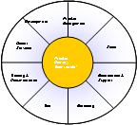
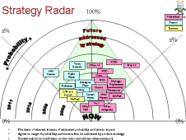
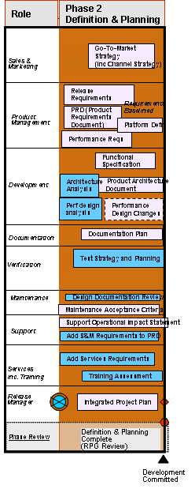
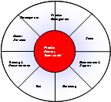
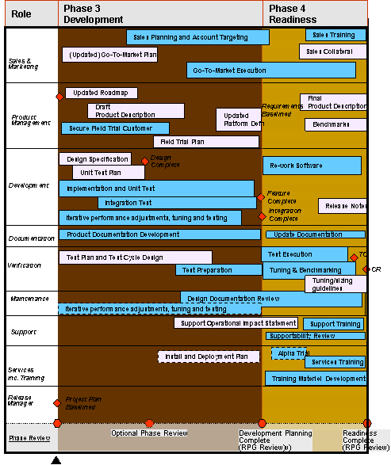
Product Lifecycle example
Annual Planning Cycle
Product Steering Committee
Product Steering Committee
Product Steering Committee
Product Steering Committee
Q n Concept Committed
Q n+1 Concept Committed
Q n+2 Concept Committed
Q n+3 Concept Committed
Q n+4 Concept Committed
Q n+5 Concept Committed
Qn Concept Committed
Development Committed
12 or 18 month roadmap
Product Steering Committee reviews and approves release
Change Control
Product Delivery Team
1 Month Definition & Planning
Product Steering Committee
Month 1 Sprint 1
Month 2 Sprint 2
Month 3 Sprint 3
Product Steering Committee
Product Steering Committee
Release
Each quarter, Product Delivery Team takes next quarter’s Concept Committed items go through Definition & Planning Phase and breaks down into 3 Agile Sprints
Product Steering Committee approves next quarter’s release plan: it becomes “Development Committed”
Product Delivery Team manages sprints and final release
Product Delivery Team
3 Months Development
1 Month Readiness

Slide 45
Release Train Example
Annual Planning Cycle
Product Steering Committee
Product Steering Committee
Product Steering Committee
Product Steering Committee
Q n Development Committed
Q n+1 Concept Committed
Q n+2 Concept Committed
Q n+3 Concept Committed
Development Committed
Development Committed
Development Committed
Delivery of major new component(s)
1 Month Defn & Plan
3 Months Development
1 Month Readiness
1 Month Defn & Plan
3 Months Development
1 Month Readiness
Activity for Qn starts beginning Q n-1
One Month contingency to meet quarterly roadmap commitment
1 Month Defn & Plan
3 Months Development
1 Month Readiness
Dev transitions smoothly from one release to the next
Ongoing development of major components

Slide 46
Ground Rules
Don’t try to jump on a moving train; you may cause a crash and kill everyone – wait for the next one
The train at the station will almost always be full – if something goes on, something else has to come off, or at least change from a Must to a Should or Could
Customers don’t (often) expect total flexibility but they like predictability: quoting a later date and then hitting it earns more loyalty longer term than aggressive but missed commitments
Product Management have to provide the change control mechanisms and communicate the changes to stakeholders in a timely manner

Slide 47
Setting the Price

Slide 48
Pricing context
Customers will pay what they think it is worth
In a perfect market that will converge with the “marginal cost” i.e. the true cost of producing the product
It’s not a perfect market – non-price sensitive customers will reveal themselves if you give them choices
Try to avoid:
Having competitors dictate the price
Having customers dictate the price
Having your margin objectives dictate the price
Having your sales people dictate the price
Holding out for aggressive discounts at the end of the quarter is a common practice for both customers and sales people – sometimes working together

Slide 49
Differentiation
Products which cost almost the same to produce can be priced very differently for customers who are not price-sensitive
Cappuccino £1.85
Hot Chocolate £1.89
Caffe Mocha £2.05
White Chocolate Mocha £2.49
Venti White Chocolate Mocha £3.09
Really means…
Cappuccino – no frills £1.85
Hot Chocolate – no frills £1.89
Mix them together – I feel special £2.05
Use a different powder – I feel very special £2.49
Make it huge – I feel greedy £3.09
Copyright Tim Harford – The Undercover Economist

Slide 50
Things are worth what people are willing to pay for them
On the sale of Rembrandt’s portrait of Aristotle for $2.3M
“There are people willing to pay a great deal to own the most expensive painting in the world. They will not pay as much for one that costs less”
Joseph Heller – Picture This
Does a Lexus RX400 cost twice as much to build as a Toyota Avensis Verso? It costs twice as much to buy…

Slide 51
Price elasticity
The correct price is that at which any price increase would reduce volume sufficiently for profit to fall, and any price decrease would not increase volumes sufficiently for profits to increase
Note that increasing or decreasing volumes can also effect your variable costs e.g. cost per item manufactured may fall as volumes grow, so this isn’t always a simple calculation
This “optimal” price may differ between customer segments – if you can avoid “leakage” between segments (geographic region or vertical) i.e. goods sold to one segment finding their way into another, then price for each segment

Slide 52
Cost, Price and Contribution Margin
Cost is not simply the effort and materials required to produce the goods.
If you’re doing A then you’re likely not doing B. The true cost of A is the effort and materials for A plus any difference in the ROI for B over A: the “opportunity cost”
Contribution Margin:
Sunk costs = cost to develop (R&D)
Variable costs = cost per item sold (manufacturing, sales, etc)
For a business which sells a large volume of products which have significant variable costs (e.g. hardware devices) then:
For a pure software business it’s more elusive because the cost is almost entirely development (sunk cost) and the cost for each additional item sold may be just be the cost of a cardboard box and a CD.
In this case consider the contribution margin of the entire Development team as:
Or per product team look at:
(Price – Variable Costs) x 100
% Contribution Margin =
Total Sales Revenue
(Sales Revenue – Sunk Cost) x 100
% Contribution Margin =
Total Sales Revenue
(Annual Sales Revenue – Annual R&D Cost) x 100
% Contribution Margin =
Total Sales Revenue

Slide 53
Contribution Margins
A mature “product” development team should drive Contribution Margins of 80% or greater.
A mass market s/w product such as those from Microsoft, can have contribution margins of >95%
Another useful metric for a business with a large software development component is average revenue per engineer: a figure of £300k p.a. or more is not an unrealistic target for a successful business

Slide 54
Product Valuation
The value of your product is the value of the nearest competitive alternative +/- the differentiation value of the features and characteristics (e.g. performance, quality) that it has or lacks wrt the alternative
You therefore need to know how much a customer needs or wants those features and that means understanding your customer and the market very well indeed. Some features are novel though – and a customer may not know they want them until they’ve seen them
When considering adding a feature you must understand both how that feature affects the value of the product, and how it will affect product sales
The “revenue horizon” must also be understood: over how long a period of time will you consider revenue?
Which of these three features is better “business”?
Total revenue is the area under the curve.
A < B < C but A is revenue right away and that can be worth more
Aggressive pricing can change the shape of the curve and bring revenue forward but will reduce the total envelope

Slide 55
Positioning

Slide 56
Positioning?
Creating a picture in the customer’s mind of your product, service or business
Creating a sense of how your offering is different from, and superior to, the alternatives
Creating, or re-inforcing, a brand or product identity with positive connotations and “good feeling”
What problem are you solving for your customer?
Why is this problem important to address?
What is the nature of your solution?
Why is yours a better solution than anyone else’s?
Why should they trust you to deliver it?
The essence of this should be communicable in less than sixty seconds: the so called “elevator pitch”. Everyone in the company should be able to deliver it.

Slide 57
Pitch Structure
For <target customers> who are dissatisfied with <current alternative>,<our product> is a <new product category> that provides <key problem solving opportunity>. Unlike a <competitive substitute>, we have assembled <key whole product features>.
Example - Palm Pilot
For travelling executives who are dissatisfied with Franklin Planners, the Palm Pilot is a personal digital assistant that provides rapid access to phone numbers and appointments. Unlike the Sharp Wizard, the Pilot can easily synchronize your data with your PC and fits in your shirt pocket.

Slide 58
Alternative Pitch Template

Slide 59
Focus on Business benefits
✗
Scalable
Flexible
Fault tolerant
✓
Increase your revenues
Reduce your risk exposure
Cut costs by 30%

Slide 60
Know your buyer
When you get past the high level pitch…
Talk in language your potential customer understands
Technical buyer – wants technical detail
Economic buyer – wants to know what the product will cost and how much it will save or earn
User buyer – wants to know how the product will improve their lives and how they would come to use it effectively
Beware of cultural differences: some cultures have a huge appetite for detail (e.g. Northern Europeans) whereas others will digest the detail outside the meeting and are more interested in the relationships (Southern Europeans)

Slide 61

Questions?

